Slide 1


Institute of Technology of Cambodia
Department of Information and Communication Engineering
COVID-19 Information
Lecturer : CHHUN Thavorac and HOK Tin
Duration : 14 March - 24 June 2022
API: https://api-node.hankimhak.tech
Client : https://covid19-web.hankimhak.tech
Admin: https://covid19-admin.hankimhak.tech

Slide 2
Team Structure
Group 1 (9 Member)
HUN Ravit
Leader
HAN Kimhak
Sub-Leader
BUN Arya
Member
BUT Dalin
Member
CHHON Devit
Member
CHHENG Afa
Member
EIV Lina
Member
HEL Sokheng
Member
KER Sokhun
Member

Slide 3
Table Content
01
Introduction
02
Features
03
Analysis
04
Implementation
05
Conclusion
06
Demo
Question & Answer

Slide 4
1. Introduction

Slide 5

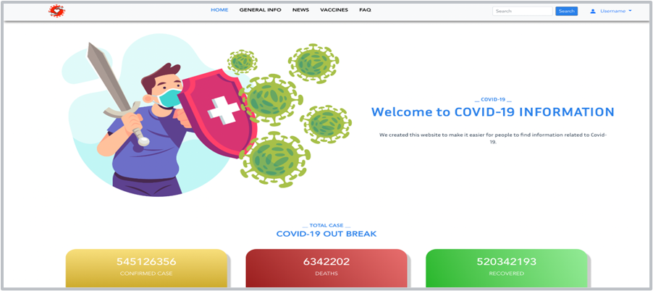
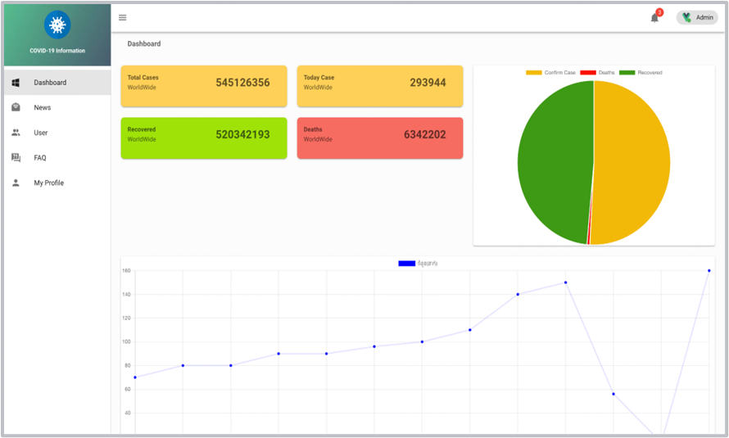
Introduction
Objective
COVID-19 Information is a website that provides information, news and questions related to covid-19.
COVID-19 Information is a website that create especially for Cambodian People to get information related to covid-19.

Slide 6
Introduction
Project Scope
Administration
Manage user information, question, faq and contact information
User Component
View information, share news, ask any questions, add news to favorite and comment.

Slide 7
2. Features

Slide 8








2. Features
MAIN FEATURE
Filter
Map Virtualization
News
Comment
FAQ
Covid Case
Favorite
Ask Question

Slide 9
3. Analysis

Slide 10












3. Analysis
Technology, Languages and Tool
Technologies
Tools
Languages

Slide 11





3. Analysis
System Architecture
JSON Request
NoSql
Web brower
JSON Response
Data
API server
(NodeJS)
Database
(MongoDB)

Slide 12
3. Analysis
Logical Architecture
Web Server
Laptop
Json Request
Authentication
Role Validation
Controller
Json Response
Model
Database
(mongoDB)

Slide 13
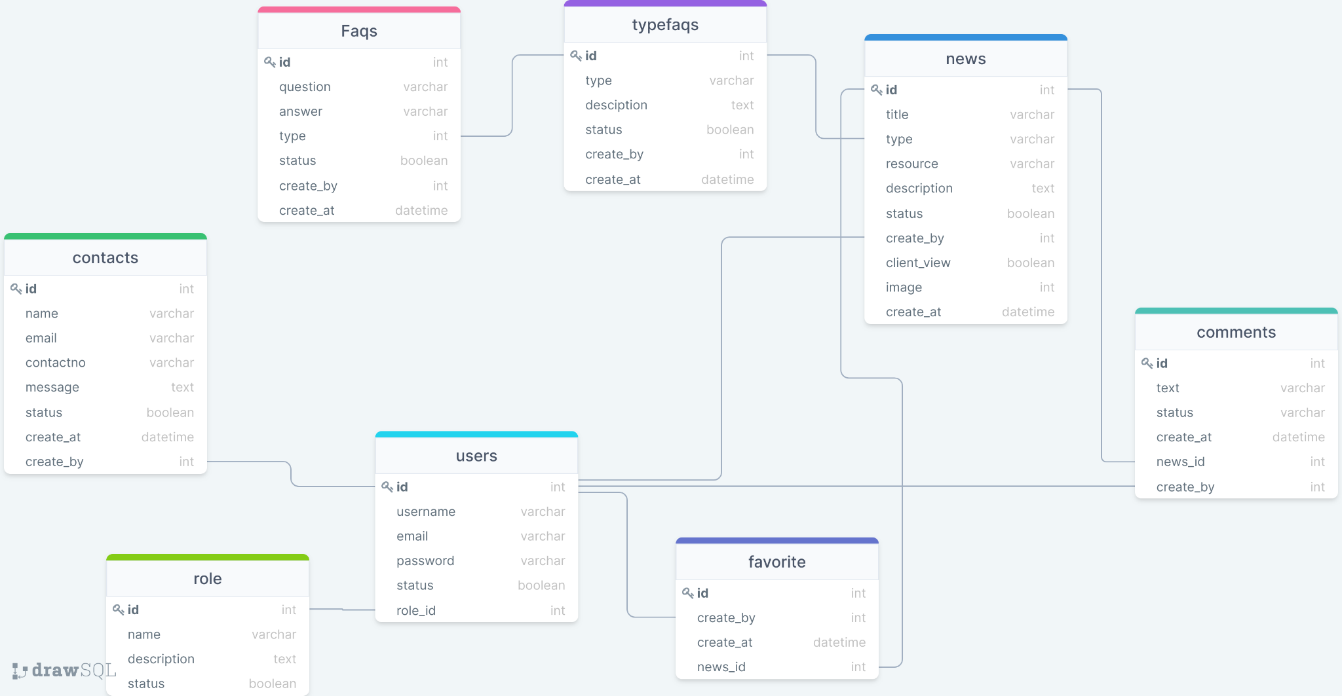
3. Analysis
Database

Slide 14
4. Implementation

Slide 15
4. Implement
Road Map
Get Information about Project Defined Problem
Front-end
Connect Front-End and Back-End
Testing
1
3
5
7
2
4
6
Analysis & Design UI
Back-end
Hosting

Slide 16
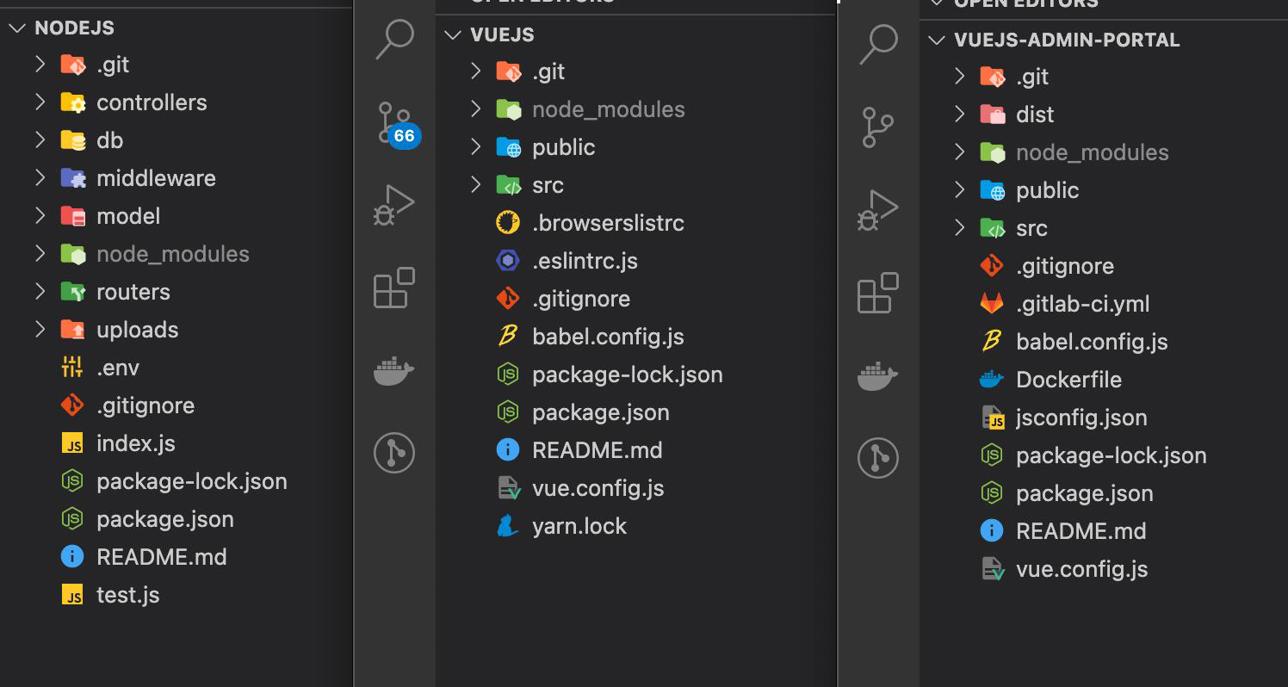
4. Implementation
Project Structure

Slide 17
4. Implementation
Admin
User
Start
Start
View all page
Log in
If invalid or User
Share news, Ask Question, Comment, Favorite
Check Role
If admin
Check cookie
If false
Log in
Create, Update, Delete, List
If true
Finish
Finish

Slide 18
5. Conclusion

Slide 19
5. Conclusion
Completed & uncompleted Task
Admin
Client
Component | Module | Functionality
Covid-19 Information | Authentication | Login,register Change password | ✔
 | Dashboard |  | ✔
 | News | Create,Update Delete, List | ✔
 | FAQ | Create,Update Delete, List | ✔
 | TypeFAQ | Create,Update Delete, List | ✔
 | Dashboard | List | ✔
 | User | Create,Update Delete, List | ✔
 | Contact | List | ✔
Component | Module | Functionality
Covid-19 Information | Authentication | Login Register | ✔
 | Homepage | View | ✔
 | News | Favorite, comment share | ✔
 | Vaccines | List | ✔
 | FAQ | List, Create | ✔
 | Contact Us | Create | ✔
 | Favorite | Create,Delete,List | ✔

Slide 20
5. Conclusion
Difficulties
Dealing with new technology
Design template
Remote meeting
Learn about fault and change

Slide 21
5. Conclusion
Experiences
Perspective
Learn new technology
Learn Project Structure
Better teamwork
Learn about fault and change
Improve code structure
Improve news
Improve comment
Add more feature

Slide 22

6. Demo

Slide 23

ADMIN COMPONENT

Slide 24

USER COMPONENT

Slide 25

Question & Answer

Slide 26


